Slide 1


Customer Satisfaction Analysis For
NI Airlines
Data Science
Group Project
Alec Musheno, Deanna Yi, Hitaishi,
Rebecca Hsiao, Shreyas Mehta, Sasha Mongia

Slide 2




table of contents
Introduction
Methodology
Key Findings
Recommendations
Appendix

Slide 3
01
Introduction

Slide 4
BUMK746 consultants: Measuring passenger satisfaction
The Dataset:
Anonymous passenger data from an airline
Includes 129,880 observations and 23 variables
The Variables:
Continuous (e.g. age, flight distance, departure delay, etc.)
Categorical (e.g. class, type of travel, gender, etc.)
Satisfaction Likert Scale from 1-5 (i.e. satisfaction with seat comfort, satisfaction within flight service, etc.)
Y-Variable: Overall satisfaction binary (either “satisfied” or not)
Our Objective:
Determine where the airline should focus its resources to efficiently improve overall customer satisfaction for key customer segments including loyal customers and business travelers.

Slide 5
02
METHODOLOGY

Slide 6

Methodology
This is a Feature Importance and Classification machine learning problem.
Divided data to 80% training, 20% test data
Used several ML algorithms to find models with the best F1, AUC, and Accuracy scores
Algorithms tested:
Decision Tree
Random Forest
Full Model Search
Forward Stepwise Regression
Ridge Regression
K-NN

Slide 7
03
Key findings

Slide 8
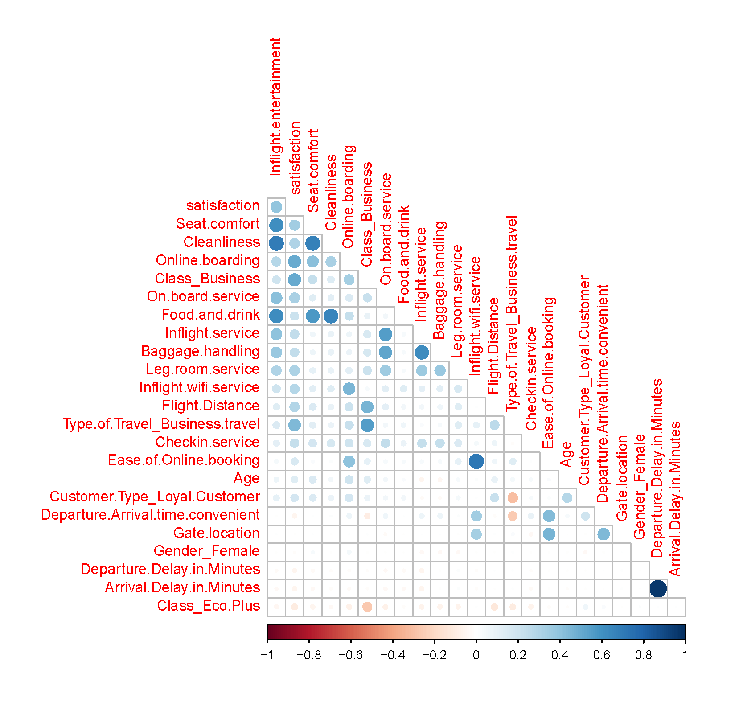

Exploratory data analysis
Overall satisfaction is highly positively correlated with…
online boarding, business class travel, seat comfort, cleanliness, onboard service and leg room service.
This gives us a preliminary sense of the variables that could play a significant role in predicting future satisfaction
There is some multicollinearity among our independent variables which we will address in our choice of machine learning algorithms.

Slide 9
Evaluation of models
 | DECISION TREE | RANDOM FOREST | LOGISTIC REGRESSION | RIDGE REGRESSION
Accuracy | 93.06% | 96.45% | 93.18% | 92.15%
AUC | 95.90% | 96.21% | 97.91% | 97.31%
F1-score | 96.42% | 96.90% | 92.17% | 90.94%
Random Forest performs best

Slide 10
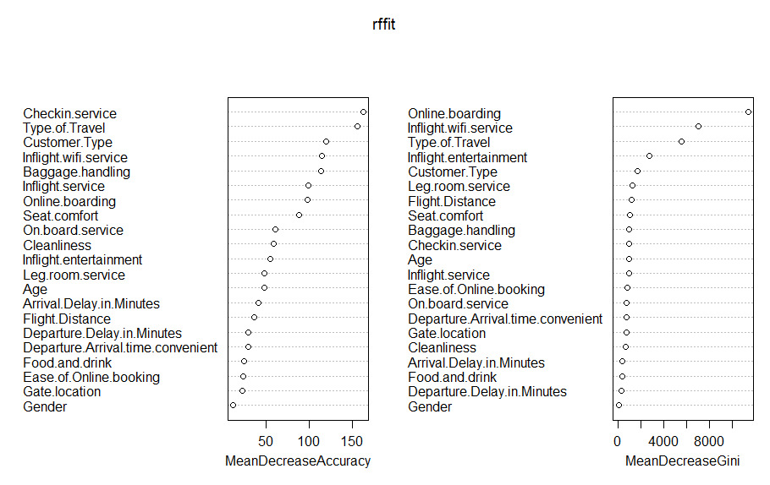
RANDOM Forest: Overall predictor variables
According to the varImplot function, the most important predictor variables are:
Checking service
Type of travel
Customer type
Inflight wi-fi service
Baggage handling
Inflight service
Online boarding
Seat Comfort
These variables have a strong relationship with the satisfaction level.

Slide 11
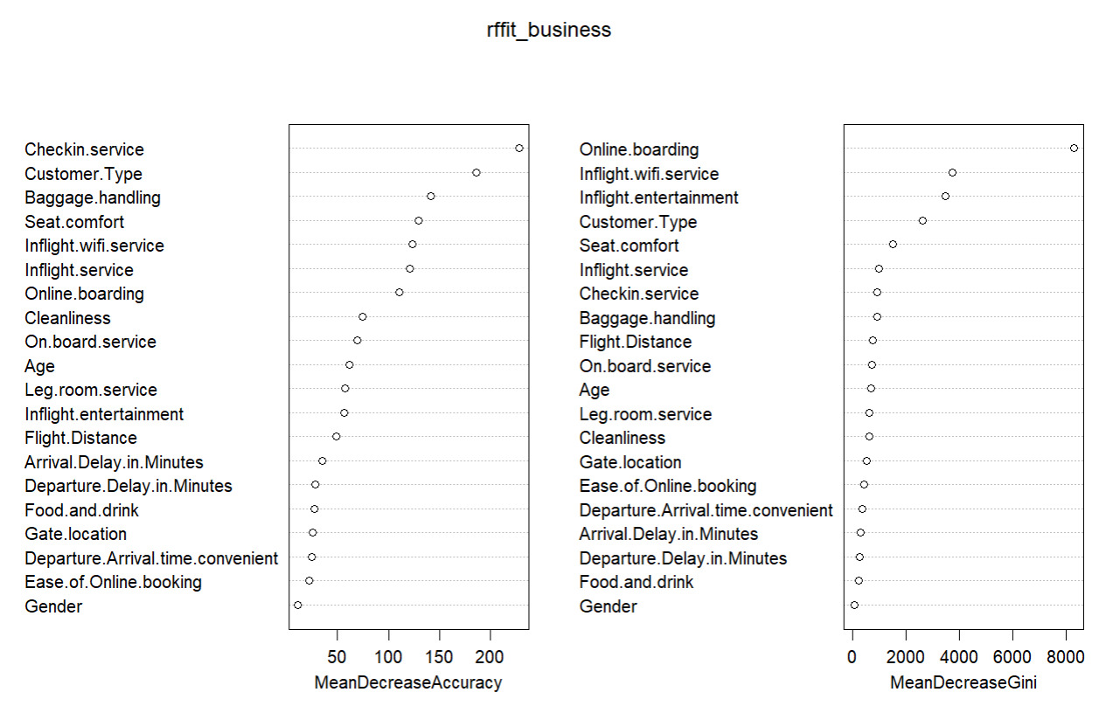
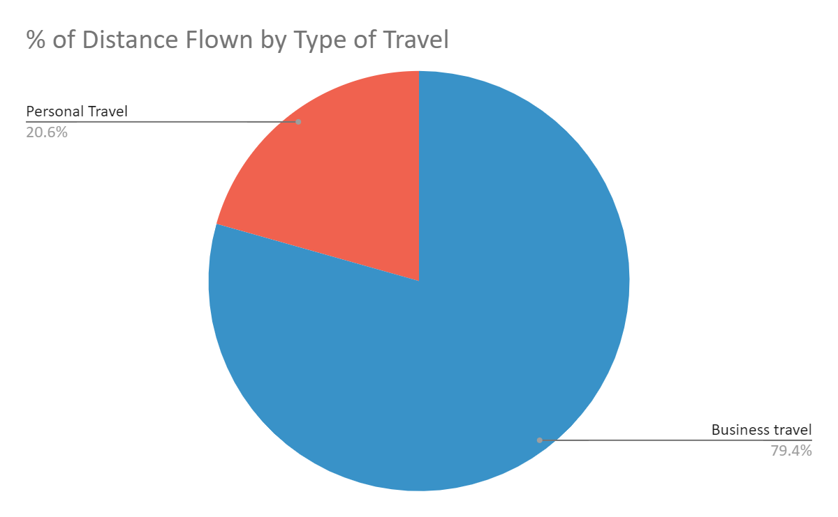
RANDOM FoREST predictor variables: BUSINESS Travel
According to the varImplot function, the most important predictor variables are:
Check-in service
Baggage handling
Seat comfort
Inflight wi-fi service
Inflight service
Online boarding
These variables have a strong relationship with the satisfaction level of people traveling for business reasons.

Slide 12
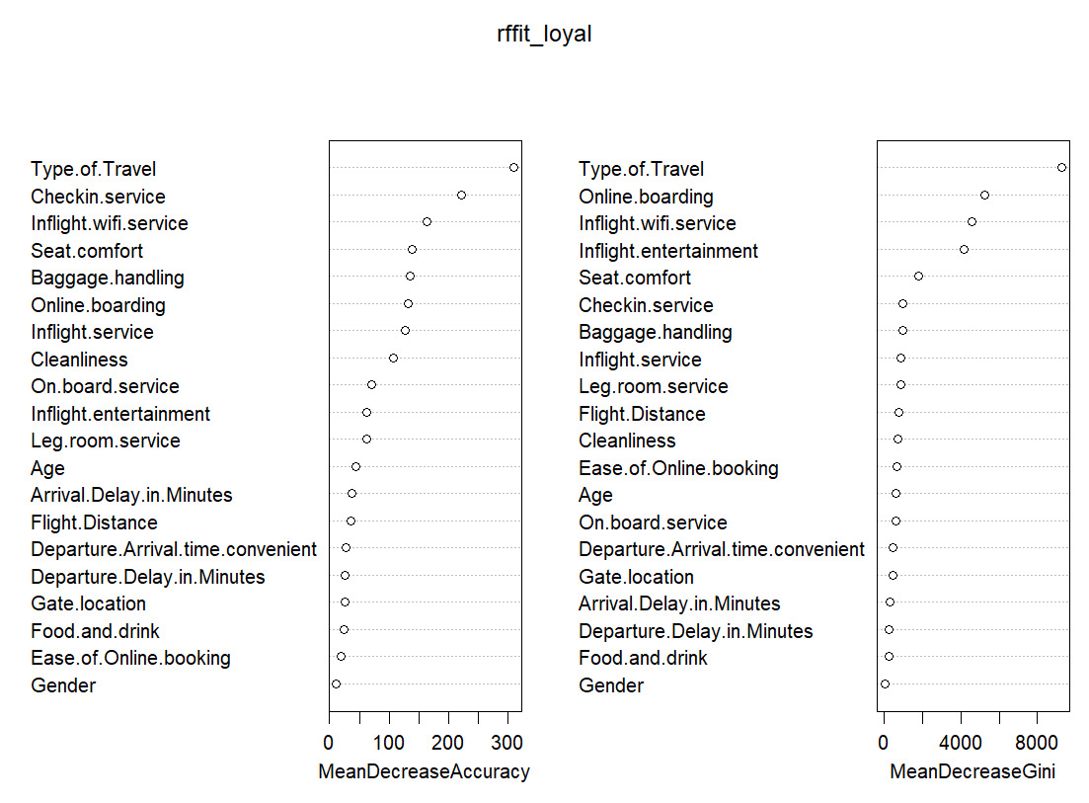
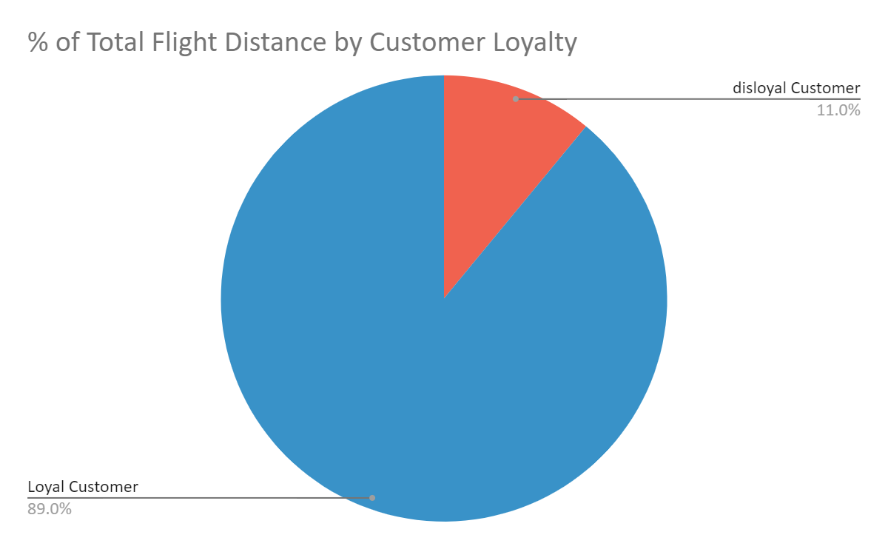

RANDOM FoREST predictor variables: Loyal Customer
According to the varImplot function the predictor variables that reduces the impurity of the nodes in the tree are:
Check-in service
Inflight wi-fi service
Seat comfort
Baggage handling
Online boarding
Inflight service
These variables have a strong relationship with the satisfaction level of the loyal customers.

Slide 13

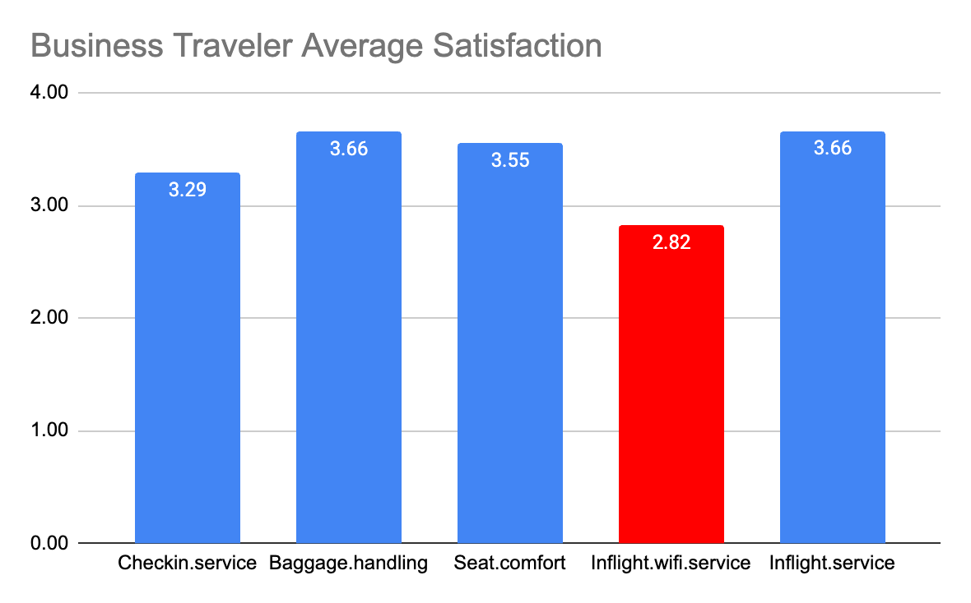
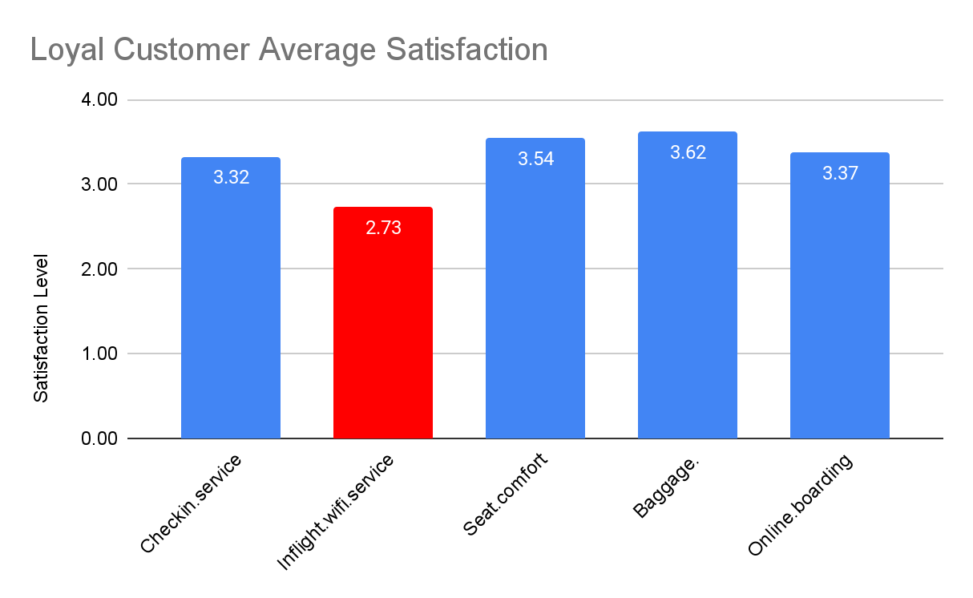
Average Satisfaction By customer segment

Slide 14
KEY FINDINGS
For all customers, a good Check-in Service is the most important factor in achieving Customer satisfaction. However, our average rating for the same is 3.14 based on the surveys conducted. Hence, further research can be conducted to understand how we can improve it.
Inflight Wi-fi service is a very important factor for satisfaction of loyal and business travelers. However, our passengers rate the airline’s Wi-fi service poorly, with an average of just 2.7 (i.e.: below average)
Business travelers and loyal travelers make up the vast majority of the miles flown.

Slide 15
04
recommendations

Slide 16
recommendations
Increase loyal customer retention
Increase satisfaction rating for in-flight wi-fi service:
Invest in stable internet connection, provide free wi-fi text messaging.
Provide free access to frequent flyers (help with conversion rate)
Collaborate with technology companies to offer passengers high-speed internet connectivity (i.e. tech companies such as Gogo, Viasat, Inmarsat)
Allow loyal customers priority check-in services (i.e. choose preferred seats 1 day before non-loyal customers)
Create a feature on the airline mobile app that provide a real-time baggage tracking option.
Enhance services offered to business traveler
These travelers can receive premium wifi in-flight free of cost
Track corporate bookings to identify business travelers and send them personalized promotions
Complimentary neck pillows, blankets, eye masks for longer flights to improve seat comfort

Slide 17
THANK YOU!
Any Questions?

Slide 18
05
APENDIX

Slide 19
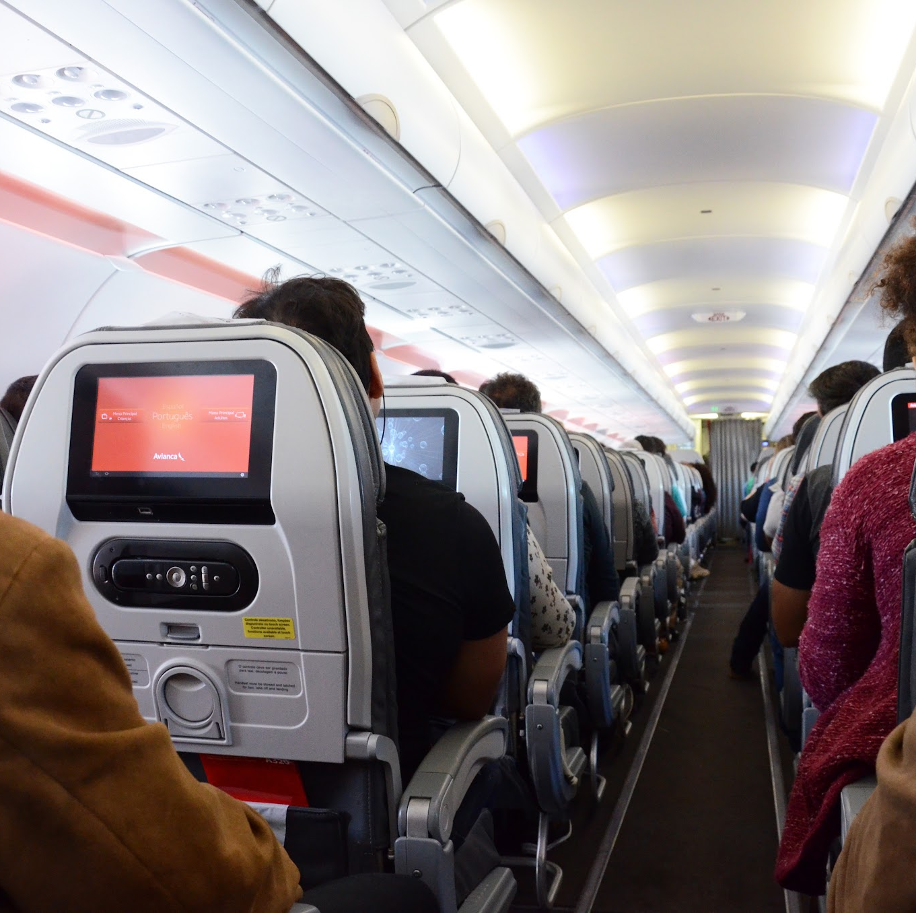
Appendix A: dataset Variables
Survey Included 23 Variables
Continuous variables: Age, Flight Distance, Arrival Delay in Minutes, Departure Delay in Minutes
Categorical Variables: Customer Type, Type of Travel, Class, Satisfaction, Likert Scale questions rating satisfaction from 1-5 on the following parameters-
Inflight Wi-fi Service
Ease of Online booking
Gate location
Food and drink
Online boarding
Seat comfort
Inflight entertainment
Onboard Service
Leg room service
Baggage handling
Check-in service
Inflight service
Cleanliness

Slide 20
Appendix B: Decision Tree Methodology
Decision Tree can be used to identify the important factors that affect customer satisfaction. The model can be trained to identify the most important features in a dataset and create a set of decision rules that can be used to predict future passenger satisfaction based on the current input data.
After performing various data cleaning techniques such as removing missing values, irrelevant columns, and standardizing the data for the analysis we divided our observations into 80% training and 20% testing.
A Decision Tree is created using the rpart() function on the training data and keeping satisfaction as the target variable and other variables as predictors.
The predictions for the training data is generated using the predict function with the type argument set to “class” to generate classification predictions.
Confusion matrix is then created to compare the predicted values to the actual values in the training and testing data set.
F1 scores were the calculated to evaluate the performance of the model

Slide 21
Appendix C: RANDOM FoREST Methodology
The purpose of Random Forest is being used to build a predictive model for the satisfaction of airline passengers based on various features such as age, gender, type of travel, departure, and arrival delay, inflight service, cleanliness etc.
After performing various data cleaning techniques such as removing missing values, irrelevant columns, and standardizing the data for the analysis we divided our observations into 80% training and 20% testing.
A random forest is fitted to the training data using the randomForest() function. The fitted model is then plotted using the plot() function.
The importance of each variable in the model is plotted varImplot() function.
We then made predictions on the training and testing data and the resulting predictions are compared with the actual data to calculate the F1 score
Once the model is trained on the historical data, it can be used to predict the satisfaction of the future airline customers by putting their information into the model.

Slide 22
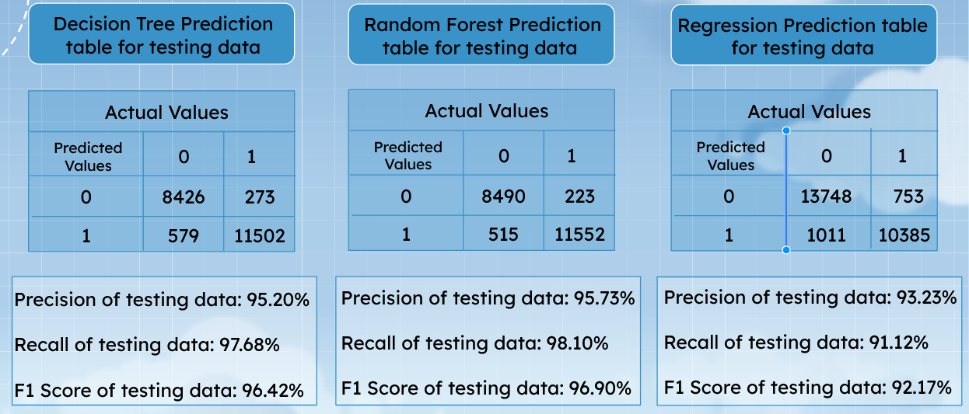
Appendix D: Evaluation of the models

